Slide 1
Reliability Mathematics

Slide 2
quantify reliability are the mathematics of probability and statistics
Reliability statistics can be broadly divided into the treatment of discrete functions, continuous functions and point processes.
For example, a switch may either work or not work when selected or a pressure vessel may pass or fail a test—these situations are described by discrete functions. In reliability we are often concerned with two-state discrete systems, since equipment is in either an operational or a failed state. Continuous functions describe those situations which are governed by a continuous variable, such as time or distance travelled

Slide 3
System Reliability
The probability of performing a mission action without a mission failure within a specified mission time t
A system with a 90% reliability has a 90% probability that the system will operate the mission duration without a critical failure
The failure rate, Lambda, provides the frequency of failure occurrences over time
The random variable in Reliability is time-to-failure
(Mean Time To Failure)
The Reliability equation for a system has the failure rate times the mission time distributed exponentially, Reliability R(t) is given by:
(λ = failure rate)
Notes:
The reliability of a system used in Requirement Documents represents the probability that the system will perform a mission action without a mission failure within a specified mission time, represented as t. A system with a 90% reliability has a 90% probability that the system will operate the mission duration t without a critical failure. The failure rate, represented as Lambda (λ), provides the frequency of failure occurrences over time.
1 divided by λ is the reciprocal of the Failure Rate. It represents the mean time to failure, typically in units of hours per failure. When the failure rate remains constant over the systems life, the reliability equation for a system has its failure rate λ times the mission time t distributed exponentially. The system’s reliability R shown as function of the mission time t is equal to the exponent of minus λ times t.

Slide 4
Additional Time to Failure Terminology
Mean Time Between Operational Mission Failure (MTBOMF) – System mission reliability often associated to an operating mission requirement, where the failure causes a mission abort or mission degradation
Mean Time Between Failure (MTBF) – System reliability typically associated to a design specification based on operating use. Per failure definition, the failure may be to any item causing a logistics demand or just critical items within the system
Mean Calendar Time Between Failure (MCTBF) – System reliability typically associated to a system operational availability based on calendar time per failure
Failure Factor (FF) – Component logistics reliability typically used for logistics support expressed in terms of failures or demands per 100 systems per year
Notes:
Additional Mean Time to Failure terminology frequently used is listed on this slide.
The Mean Time Between Operational Mission Failure (MTBOMF) is often applied to a system mission reliability requirement where the system’s failure causes a mission abort of mission degradation.
Mean Time Between Failures (MTBF) is often applied in a system reliability design specification. MTBF is also based on system operating time only. Depending on the failure definition used, the failure may be to any item causing a logistics demand or just to critical item failures within the system.
The Mean Calendar Time Between Failures (MCTBF) is applied as a system reliability term tied to Operational Availability (Ao), which is based on the calendar time per failure.
The Failure Factor is typically a component logistics reliability time to failure term tied to the calendar time frequency of logistics support. A Failure Factor is expressed in terms of failures or demands per 100 systems per year.

Slide 5

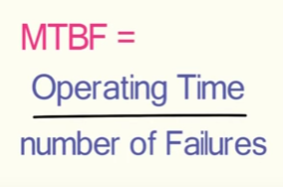
MTBF (Mean Time Between Failure)
Mean Time Before failure is a measure of total uptime of the components(s) divided by the total number of failures.

Slide 6

Failure Rate
Failure Rate is a simple calculation derived by taking the inverse of the mean time between failures:
Failure rate is most commonly measured in number of failures per hour.

Slide 7

MTTR (Mean Time To Repair)
Mean Time To Repair (MTTR) is a measure of the average downtime. the formula for which is:

Slide 8
Availability
Considers both reliability (probability the item will not fail) and maintainability (probability the item is successfully restored after failure)
Reliability, Availability, and Maintainability (RAM) are always associated with time
Availability is the probability that the system/component is operational at a given time, t (i.e. has not failed or it has been restored after failure)
May be defined as the probability an item is operable & can be committed at the start of a mission when the mission is called for at any unknown (random) point in time. Example: For a lamp with a 99.9% availability, there will be one time out of a thousand that someone needs to use the lamp and finds it is not operating
Notes:
Availability considers reliability, which covers the probability that the item will not fail and considers maintainability, which covers the probability that the item is successfully restored after failure.
Reliability, Availability, and Maintainability known as the acronym RAM, are always associated with time. Availability is a probability that the system or component is operational at a given time, t. If an item has not failed or if the item has been restored after failure, it is considered operational.
Availability may also be defined as the probability an item is operable and can be committed at the start of a mission when the mission is called for at any unknown (random) point in time. For example, for a lamp with a 99.9% availability, there will be one time out of a thousand that someone needs to use the lamp and finds it is not operating.

Slide 9
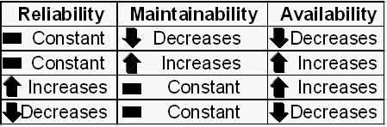
RAM Relationships
Availability alone tells us nothing about how many times the lamp has been replaced
Reliability and Maintainability metrics are still important. The table illustrates RAM relationships
Notes:
Availability alone tells us nothing about how many times the lamp has been replaced. The lamp could have been replaced ever day or the lamp may never have been replaced. Therefore, reliability and maintainability metrics are still important and needed.
The table illustrates RAM relationships. If reliability remains constant and maintainability decreases to a larger time to repair, the availability will decrease. Conversely, if reliability remains constant and maintainability increases to a smaller time to repair, then availability will increase. If reliability increases to a larger time to failure and maintainability remains constant, then availability will increase. Conversely, if reliability decreases to a smaller time to failure and maintainability remains constant, then availability will decrease.

Slide 10


Inherent Availability
The steady state availability when considering only the corrective downtime of the system
For a single component, this can be computed by:
- For a system, the Mean Time Between Failures, or MTBF, is used to compute inherent availability:
Notes:
Inherent Availability is the steady state availability when considering only the corrective downtime of the system. For a single component, this can be computed as the Mean Time To Failure divided by quantity of the Mean Time To Failure plus the Mean Time To Repair. For a system, the Mean Time Between Failures, or MTBF, is used to compute inherent availability. Inherent Availability is the responsibility of the system designer and equipment manufacturer.

Slide 11
MTBF = Uptime / Number of System Failures
MTTR = CM Downtime / Number of System Failures

Slide 12

Achieved Availability
Achieved Availability is similar to Inherent Availability except Preventive Maintenance (PM) is also included
The steady state availability when considering the corrective and preventive downtime of the system
Computed by looking at the Mean Time Between Maintenance actions, MTBM and the Mean Maintenance Downtime:
Notes:
Achieved Availability is very similar to Inherent Availability with the exception that Preventive Maintenance downtimes are also included. Specifically, it is the steady state availability when considering the corrective and preventive downtime for the system. Achieved Availability is computed as the Mean Time Between Maintenance actions or MTBM divided by the MTBM plus the Mean Maintenance Downtime. Achieved Availability is also the responsibility of the system designer and equipment manufacture.

Slide 13
There are two components to the system availability formula. The first is total uptime and the second is total downtime. Uptime is any time that asset is performing at a normal output. Downtime is any time the equipment is not available for production, including planned and unplanned downtime.

Slide 14
Operational Availability
Operational Availability is the percentage of calendar time to which one can expect a system to work properly when it is required
Expression of User Need rather than just Design Need
Operational Availability is the ratio of the system Uptime and Total time. Mathematically, it is:
Includes all experienced sources of downtime, such as administrative downtime and logistic downtime to restore the system
Notes:
Operational Availability is the percentage of calendar time to which one can expect a system to work properly when it is require. Ao is an expression of User Need rather than just Design Need.
Operational Availability is the ratio of the system Uptime and Total time. Mathematically, it is Uptime divided by the quantity of Uptime plus Downtime, which represents Total Time. Ao includes all experienced sources of downtime, such as administrative downtime and logistics downtime to restore the system.
Some of the downtime factors are beyond the responsibility of the system designer making logistics planning and analysis very important when Ao is required or desired by the user of the system.

Slide 15

Ao / Operational Readiness Example
A diesel power generator is supplying electricity at a research site in Antarctica & personnel are not satisfied with the generator
In the past six months, they estimate being without electricity due to generator failure for an accumulated time of 1.5 months
Therefore, the operational availability of the diesel generator experienced by personnel of the station is:
Notes:
As an Operational Availability (Ao) or Operational Readiness Rate example, consider the following scenario. A diesel power generator is supplying electricity at a research site in Antarctica and the personnel there are not satisfied with the generator. In the past six months, they estimate being without electricity due to generator failure for an accumulated time of 1.5 months. Therefore, the Ao of the diesel generator experienced by personnel of the station is 75% as shown by being up only 4 ½ months over a 6 month timeframe.

Slide 16

availability
availability—the probability that a system is functioning when needed, under normal operating conditions.

Slide 17
Reliability Formula
Where t is the mission time and e is a constant value of 2.71828.
Failure rate = Lambda = l = f/n
Where f = the total failures during a given time interval and n = the number of units or items placed on test.
A sample of 450 devices were tested for 30 hours and 5 failures were recorded. The device is designed to operate for 1000 hours without failure. What is the reliability of the tested device?
Failure rate = l = 5/(450)(30) = 5/13500 = .0003704
Reliability = e - = e - (.0003704)(1000) = e - .3704 = .6905
The probability of a device operating for 1000 hours without a failure is .69.05%.

Slide 18
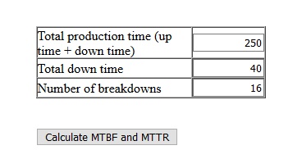
Exercise
Mean Time To Repair = (Total down time) / (number of breakdowns)

Slide 19
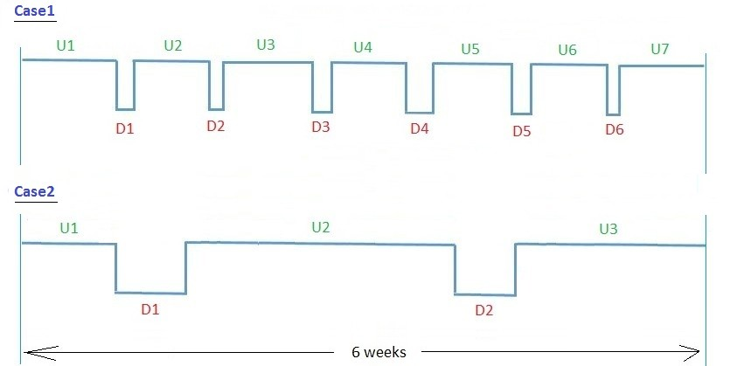
Exercise2

Slide 20
Total Uptime = U1 + U2 +U3 + U4 + U5 + U6 + U7. = Say 900 Hrs.
Total Downtime = D1 + D2 + D3 + D4 + D5 + D6. = Say 108 Hrs.
We know that MTTR (Mean Time to Repair in Hrs) = ( D1 + D2 + D3 + D4 + D5 + D6 ) / 6 = 18 .
Similarly MTBR (Mean Time Between Repairs in Hrs) = ( U1 + U2 +U3 + U4 + U5 + U6 + U7 ) / 6 = 150 .
Now,
Equipment Availability (%) is: UpTime / Total Time = (900 / 1008) * 100 = 89.2
Another formula for Equipment Availability in practice is [MTBR / (MTTR + MTBR)] * 100 = (150 / 168 )*100 = 89.2

Slide 21
Case2:
No. of Failures = 2 (Denominator for MTTR, MTBR Calculations)
Suppose here too we get the same total values like:
Total Uptime = U1 + U2 +U3 = Say 900 Hrs
Total Downtime = D1 + D2 = Say 108 Hrs
MTTR (H) = ( D1 + D2) / 2 = 54 .
MTBR (H) = ( U1 + U2 + U3) / 2 = 450 .
Equipment Availability (%) is: Uptime / Total Time = (900 / 1008) * 100 = 89.2
Through other formula for Equipment Availability : [MTBR / (MTTR + MTBR)] * 100 = (450 / 504 )*100 = 89.2

Slide 22
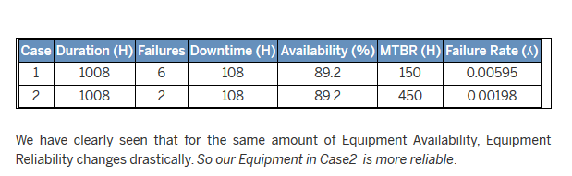
What is Reliability?

Slide 23
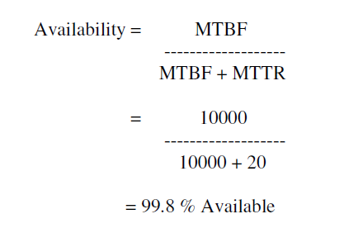

Slide 24
Measuring Availability
Mean time to failure (MTTF)
Mean time to repair (MTTR)
MTBF = MTTF + MTTR
Availability = MTTF / (MTTF + MTTR)
Suppose OS crashes once per month, takes 10min to reboot.
MTTF = 720 hours = 43,200 minutes MTTR = 10 minutes
Availability = 43200 / 43210 = 0.997 (~“3 nines”)

Slide 25
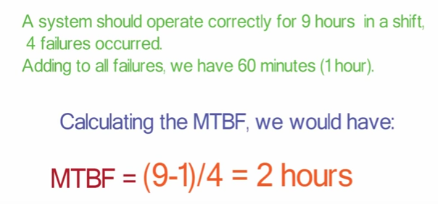

Slide 26
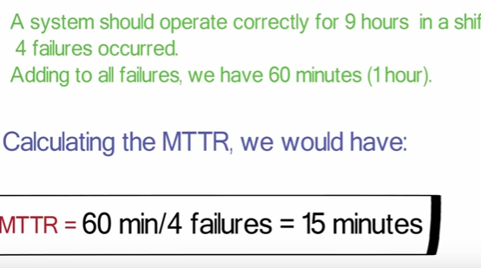

Slide 27
MTTF=3 years MTTR=1 day
MTBF = MTTF + MTTR = 3 years + 1 day = 3 years * 365 days + 1 day = 1095 + 1 = 1096 days = 1096

Slide 28
Series system Calculation of reliability
System fails if any one of its components fails
1
2
…
n
Independent components
R_{S}=R₁⋅… ⋅ R_{n}

Slide 29
Parallel system: calculation of reliability
System survives if one component survives
1
2
n
3

Slide 30
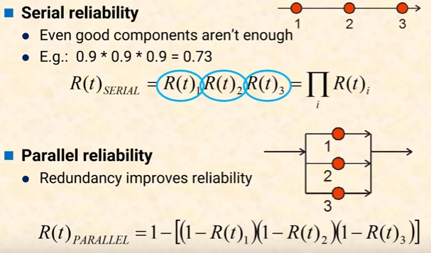

Slide 31
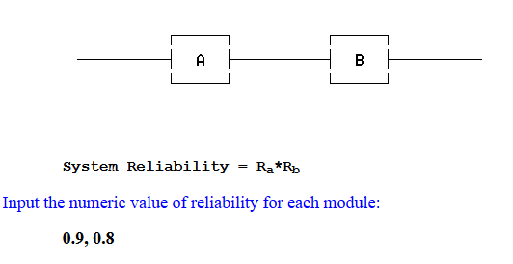
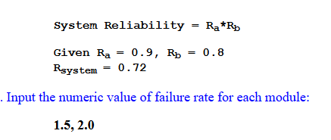
Sample 1 --- a simple series system
System Reliability = e^{-1.5t}*e^{-2t}

Slide 32
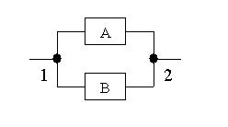
Sample 2 --- a simple parallel system
System Reliability = 1-(1-R_{a})*(1-R_{b}) 3. Input the numeric value of reliability for each module: 0.9, 0.8
System Reliability = 1-(1-R_{a})*(1-R_{b})
Given R_{a} = 0.9, R_{b} = 0.8 R_{system} = 0.98

Slide 34
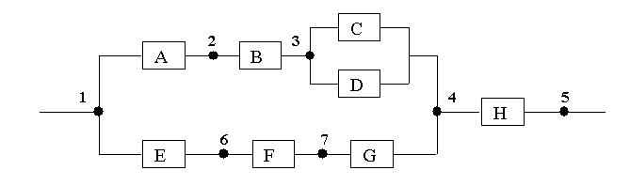
Sample 3 --- a series/parallel system
System Reliability = (1-(1-R_{a}*R_{b}*(1-(1-R_{c})*(1-R_{d})))*(1-R_{e}*R_{f}*R_{g}))*R_{h}
3. Input the numeric value of reliability for each module: 0.9, 0.8, 0.7, 0.8, 0.9, 0.5, 0.6, 0.9
System Reliability = (1-(1-R_{a}*R_{b}*(1-(1-R_{c})*(1-R_{d})))*(1-R_{e}*R_{f}*R_{g}))*R_{h}
Given R_{a} = 0.9, R_{b} = 0.8, R_{c} = 0.7, R_{d} = 0.8, R_{e} = 0.9, R_{f} = 0.5, R_{g} = 0.6, R_{h} = 0.9, R_{system} = 0.6876576000000001

Slide 35
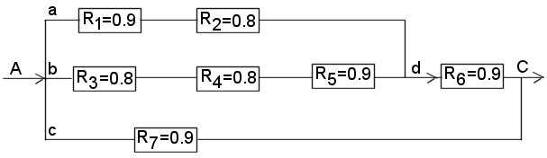
Reliability Modeling: Combination of Series and Parallel

Slide 36
R_{ad} = R₁ · R₂ = (0.9)(0.8) = 0.72
R_{bd} = R₃ · R₄ · R₅ = (0.8)(0.8)(0.9) = 0.576
but R_{ad} and R_{bd} are in parallel; thus, the unreliability of this parallel subsystem (S₁) is
Q_{S1} = Q_{ad} · Q_{bd} = (1 – R_{ad})(1 – R_{bd}) = (1 – 0.72)(1 – 0.576) = (0.28)(0.424) = 0.119
and its reliability is
R_{S1} = 1 – Q_{S1} = 1 – 0.119 = 0.881

Slide 37
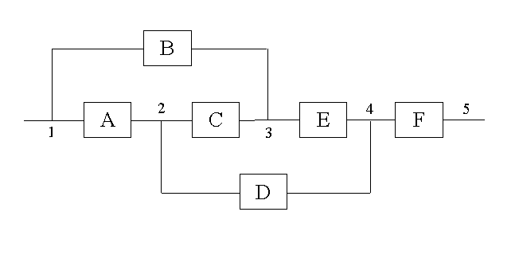
Sample 4 --- a non-series/parallel system

Slide 38
System Reliability = - R_{a}*R_{b}*R_{c}*R_{e}*R_{f} + R_{a}*R_{b}*R_{c}*R_{d}*R_{e}*R_{f} + R_{a}*R_{d}*R_{f} + R_{b}*R_{e}*R_{f} - R_{a}*R_{b}*R_{d}*R_{e}*R_{f} + R_{a}*R_{c}*R_{e}*R_{f} - R_{a}*R_{c}*R_{d}*R_{e}*R_{f}
3. Input the numeric value of reliability for each module: 0.9, 0.8, 0.7, 0.5, 0.9, 0.9
Given R_{a}=0.9, R_{b}=0.8, R_{c}=0.7, R_{d}=0.5, R_{e}=0.9, R_{f}=0.9,
R_{system} = 0.8124300000000002

Slide 39
Pressure
Switch
Alarm
at
P > P_{A}
PIA
PIC
Pressure
Feed
Solenoid
Valve
Reactor
A chemical reactor with an alarm and inlet feed solenoid. The alarm and feed shutdown systems are linked in parallel.

Slide 41
Alarm System
The components are in series
Faults/year
years

Slide 42
Shutdown System
The components are also in series:

Slide 43
The Overall Reactor System
The alarm and shutdown systems are in parallel:

